Slide 1
Clean Energy Communities: Leadership Round

Slide 2
Logistics
We will be turning off cameras and muting all attendees
Please enter questions in the chat, we will answer at the end
This webinar is being recorded and will be posted on our website and emailed to attendees

Slide 3
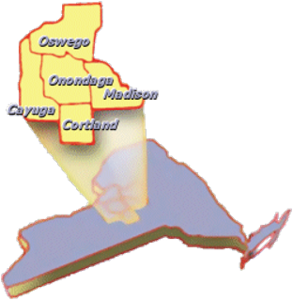
CNY RPDB
Energy Management​
Comprehensive Planning and Community Development​
Economic Development​
Environmental Management​
Transportation Planning

Slide 4
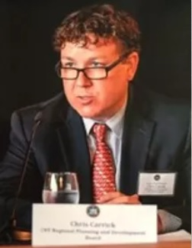
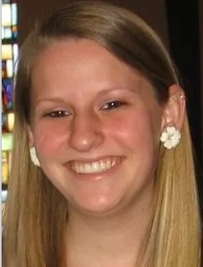
Our Team
CNY RPDB is helping municipal governments in Central New York pursue clean energy actions in the hopes of creating designated Clean Energy Communities.
Chris Carrick – CNY RPDB Program Manager and CEC Coordinator
Amanda Mazzoni – CNY RPDB Senior Planner and CEC Coordinator

Slide 5
Climate Leadership and Community Protection Act Goals
Point Tiers
By 2030
By 2040
By 2050
70% electricity from renewable resources
40% reduction in GHG emissions (from 1990 levels)
100% zero-emission electricity
85% reduction in GHG emissions (from 1990 levels)
*Local governments are needed to reach these goals!*

Slide 6
What are Clean Energy Communities?
New York State Energy Research and Development (NYSERDA) Program
Purpose:
To encourage NYS communities to implement clean energy actions, save energy costs, create jobs, and improve the environment. In addition to providing tools, resources, and technical assistance, the program recognizes and rewards leadership for the completion of clean energy projects.
The program is designed for: Counties, Cities, Towns and Villages

Slide 7
What does a CEC Coordinator do?
Help your municipality to become a Clean Energy Community
Educate your community about the Clean Energy Communities Program
Help your community to identify, implement, and achieve clean energy actions
Assist your community to complete clean energy actions in the program
Guide your community on document submission for completed actions and grant applications
Provide your community with tools and analysis
Create resources for your community

Slide 8
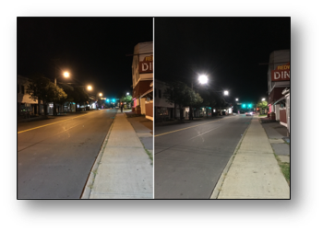
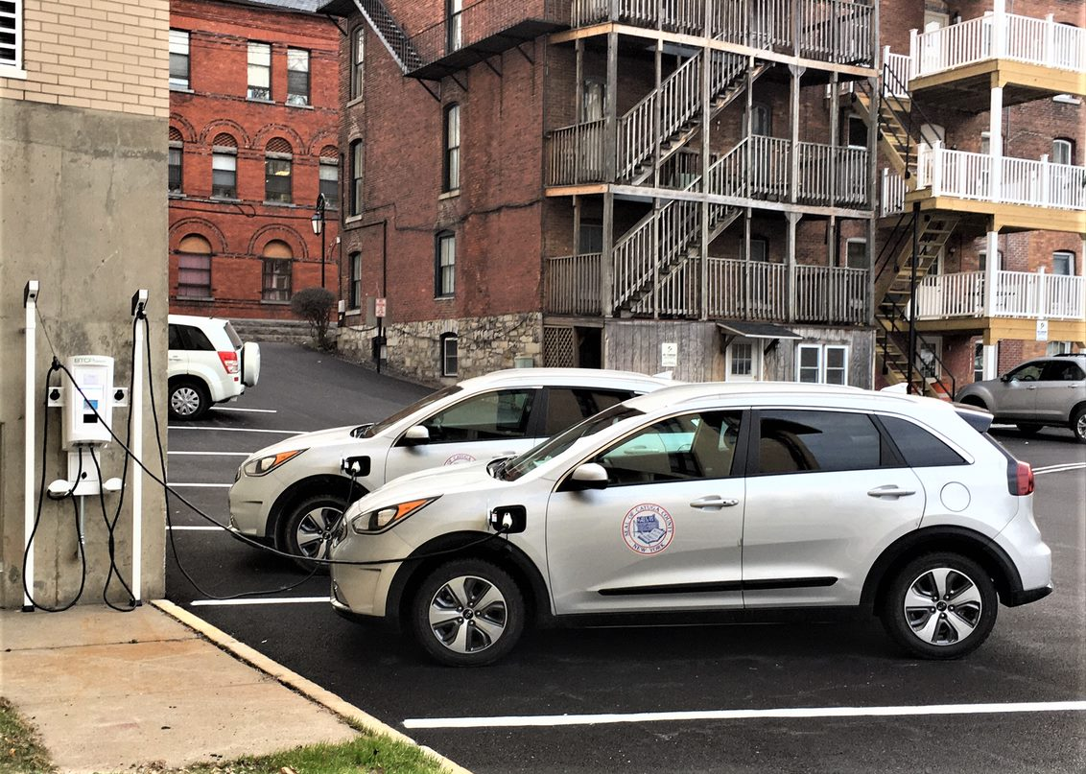
WHY CEC?
FOR MUNICIPALITIES
Opportunity to obtain additional funding for clean energy projects
CEC Grants
As actions are completed, municipalities can save money
Technical assistance to help track and complete desired energy actions
Municipalities will be recognized as leaders in Clean Energy
W Manlius St., Village of East Syracuse
before (left) and after (right) LED streetlight conversion
Cayuga County purchased two Kia Niro SUV PHEVs and installed a charging station at their county building in Auburn using CEC grant funds from round 1

Slide 9
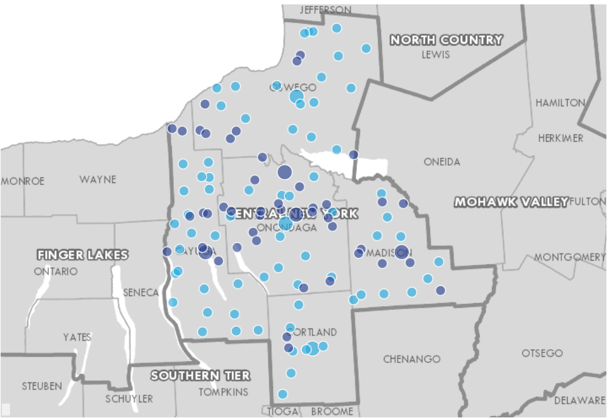
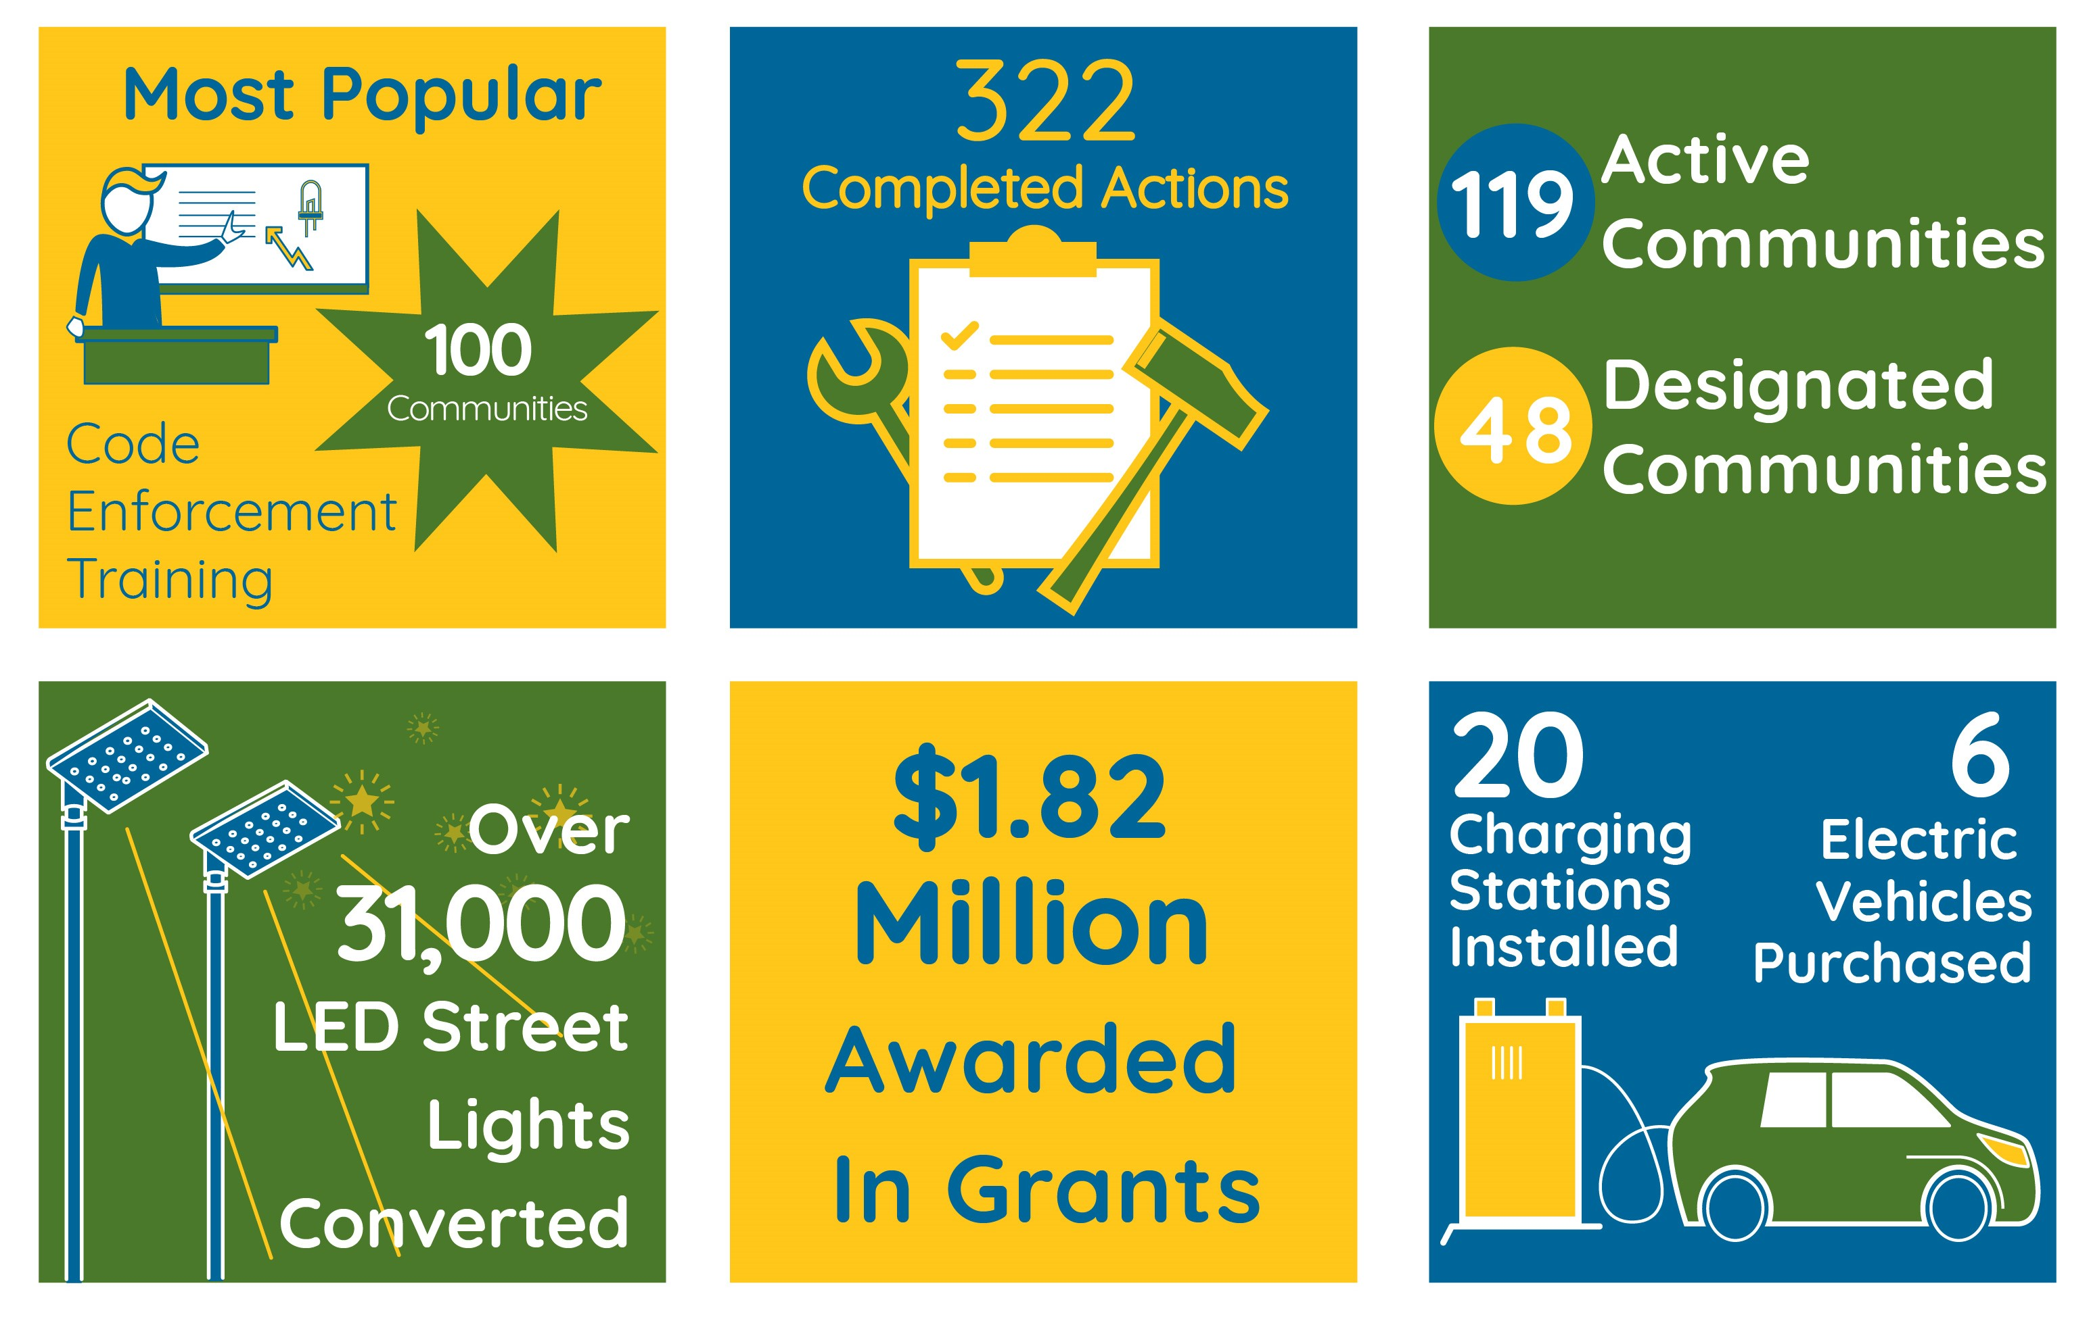
CEC 2016 - 2020
More than any other region!
Designated Clean Energy Community
Active Clean Energy Community

Slide 10
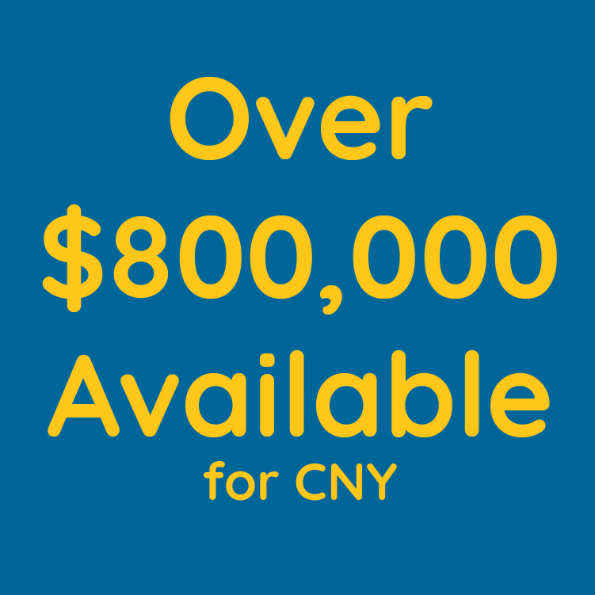
CEC Leadership Round
January 2021 NYSERDA released the Clean Energy Communities Leadership Round
New clean energy actions
New ways for communities to be recognized as leaders
Over $800,000 in funding earmarked just for CNY and three ways to achieve funding

Slide 11
Grant Funding

Slide 12
Three ways to get funding (*Available to municipalities that pay SBC on electric bills*)
1) Designation Grants
Complete 4 High Impact Actions to become a designated community and receive $5,000
2) Action Grants
Certain actions award additional funding when they are completed
3) Point-Based Grants
Collect points by completing High Impact Actions to receive more grant money

Slide 13
Point-based Grants
Point Tiers
EARN 3,000+ POINTS
EARN 4,000+ POINTS
EARN 5,000+ POINTS
In some cases, points will be assigned retroactively for previous completion of Impact Actions
Pop. 40,000+
$30,000 50 grants statewide
$70,000 20 grants statewide
$150,00 10 grants statewide
Municipality Size
Pop. < 40,000
$10,000 40 grants per region
$20,000 10 grants per region
$70,000 4 grants per region
Over $800,000 in grant money just for CNY!

Slide 14
Points Grants are based on Region for Municipalities with Population <40,000
“First Come, First Serve” process – once the grants are gone, they’re gone
Our region includes:
Cayuga, Cortland, Madison, Onondaga, and Oswego Counties

Slide 15
Disadvantaged Community Bonus
Any points-based or action grant award in the amount of $20,000 or greater may be eligible for $10,000 bonus funding for a clean energy project.
To access a bonus, the grant project needs to be located within a New York State “Disadvantaged Community” as explained on NYSERDA’s website: www.nyserda.ny.gov/ny/disadvantaged-communities.
Central NY communities that meet the definition include: parts of the City of Syracuse, City of Cortland, City of Auburn, City of Oswego, City of Fulton, Town of Scriba, Town of Oswego, Village of Phoenix, and Town of Schroeppel, and the entire Town and Village of Richland/Pulaski

Slide 16
How to apply for grants:
Once a community qualifies for a grant they have 90 days from their notification (via email) to submit a grant application.
Grants will have no required cost share
Grants $5,000 or less = no contract
Check in the mail
Larger grants require municipality to select pre-approved project type or apply for a custom project
Eligible pre-approved project types:
Conversion to LED streetlights
Installation of solar
Purchase of electric vehicles
Installation of EV charging stations
Implementation of Clean Energy projects
Custom projects will be required to meet certain metrics and may take longer to be approved than pre-approved project types.

Slide 17
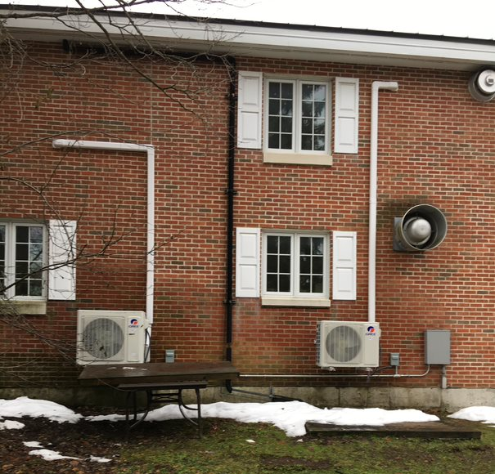
Examples of CEC Grant Projects
Town of Richland Solar Array
Village of Cazenovia Heat Pumps

Slide 18
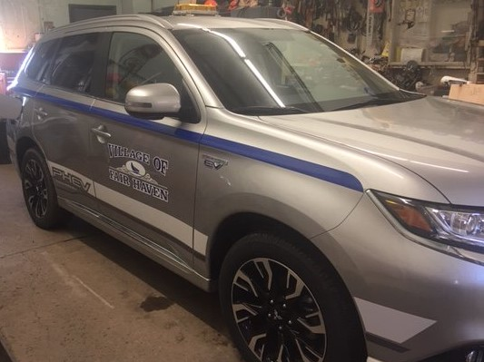
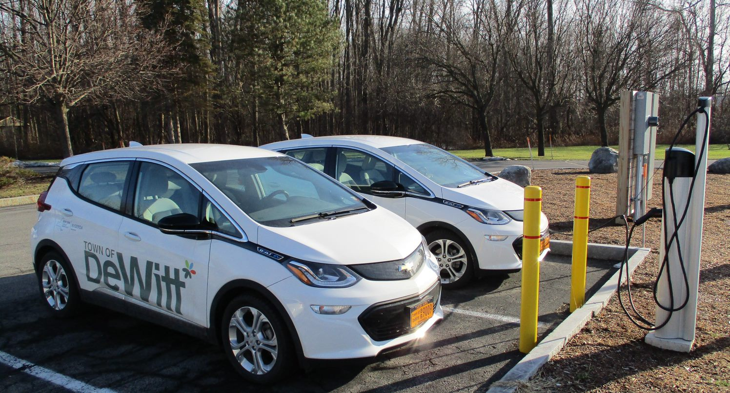
Examples of CEC Grant Projects
Village of Fair Haven PHEV
Town of DeWitt EVs and Charging Stations

Slide 19
High Impact Action Items
ITEM BREAKDOWN

Slide 20
Original CEC High Impact Actions continuing in Leadership Round
200 POINTS | UNIFIED SOLAR PERMIT
 | Adopt the New York State Unified Solar Permit to streamline the approvals process for solar
200 POINTS | ENERGY CODE ENFORCEMENT TRAINING
 | Train code compliance officers in best practices in energy code enforcement
Up to 500 POINTS | PACE FINANCING
 | Authorize a financing program for clean energy upgrades to commercial or non-profit property
500 POINTS | CLEAN ENERGY UPGRADES
 | Achieve a 10 percent reduction in the greenhouse gas emissions from municipal buildings
Up to 900 POINTS | LED STREET LIGHTS
 | Convert at least half of the municipal cobra-head or decorative-style street lights to LED
Up to 1,000 POINTS | BENCHMARKING
 | Adopt a policy to track and report the energy use of municipal buildings or large private buildings
Up to 1,000 POINTS | CLEAN FLEETS
 | Deploy light to heavy duty electric vehicles or install charging stations
Up to 800 POINTS | CLIMATE SMART COMMUNITIES CERTIFICATION
 | Earn Climate Smart Communities (CSC) Certification to reduce carbon emissions and build resilience
Up to 2,000 POINTS | COMMUNITY CHOICE AGGREGATION
 | Dramatically reduce carbon emissions by transitioning to a clean, renewable electricity supply
Many of these might be actions that your community has already completed through the first iteration of the program

Slide 21
CEC Leadership Round New High Impact Actions
New Actions
Actions with associated grants
500 POINTS | CLEAN HEATING AND COOLING DEMO
 | Convert a municipal facility to all-electric with ground- or air-source heat pumps or solar thermal
500 POINTS | 100% RENEWABLE ELECTRICITY
 | Use renewable energy resources for all the electricity supply needs of municipal government - requires purchase of Renewable Energy Certificates (RECs) that are retired in New York State Generation Attribute Tracking System (NYGATS)
1,200 POINTS | UP TO $50,000 (only through 12/31/21) | NYSTRETCH ENERGY CODE
 |  | Adopt a local energy code that is more stringent than the state base energy code
Up to 800 POINTS | UP TO $60,000 | COMMUNITY CAMPAIGNS
 |  | Undertake one or more campaigns to promote clean energy in your community (includes Community Solar, Electric Vehicles, Clean Heating and Cooling, and Demand Response campaign types)

Slide 22
Leadership Round Points & Grants: New Community Example
New Community in CEC 2.0
Community Campaigns (Clean Heating and Cooling) – 200 points
Benchmarking (Municipal Buildings) – 100 points
Community Choice Aggregation – 1,500 points
LED Streetlights (Cobra Heads) – 700 total points
Total Points = 2,500 points
Eligible for:
$5,000 Designation Grant
$5,000 – $15,000 Action Grant, depending on population
500 more points would make the community eligible for a Points-based grant

Slide 23
Leadership Round Points & Grants: Active Community Example
Active Community in CEC 1.0
Active Community in CEC 2.0
Unified Solar Permit – 200 points
Benchmarking (Municipal Buildings) – 100 points
Clean Fleets (EV Charging Station) – 200 points
NYStretch Code – 1,200 points
Climate Smart Communities – 600 points
LED Streetlights (Cobra Heads) – 700 points
Two actions completed ​
Go into CEC 2.0 with 300 points
New actions completed = 2,700 points​
Total including CEC 1.0 actions = 3,000 points​
Can apply for $5,000 Designation-grant​
Can apply for $10,000 – $30,000 Points-based grant​
Eligible for $5,000 – $50,000 Action grant

Slide 24
Leadership Round Points & Grants: Previously Designated Community Example
Designated Community in CEC 1.0
Designated Community in CEC 2.0
Unified Solar Permit – 200 points
Clean Fleets (EV Charging Station) – 100 points
Benchmarking (Municipal Buildings) – 100 points
Community Choice Aggregation – 1,500 points
Clean Energy Upgrades – 500 points
Benchmarking (Adv. Reporting) - 200 points
Clean Heating and Cooling Demo – 500 points
Climate Smart Communities – 600 points
LED Streetlights (Cobra Heads) – 700 points
Four actions completed = designated community​​
Grant Received in Round 1 $5,000 – $250,000​
Go into CEC 2.0 with 1,900 points
New actions completed = 2,600 points​
Total with CEC 1.0 = 4,500 points​
Eligible for $10,000 – $30,000 Points-based grant ​ & $20,000 – $70,000 Points-based grant

Slide 25
Next Steps
Designate a main contact that will represent the municipality and work directly with the Clean Energy Communities Coordinators
Discuss what actions have been accomplished and what actions the municipality has an interest in accomplishing
Set up follow up meetings to begin work on actions the municipality wants to accomplish
Find/create/submit documentation of completed action
Begin thinking about projects that the municipality has an interest in using grant funding for

Slide 26
Contact
Amanda Mazzoni
CNY RPDB Senior Planner and Clean Energy Communities Coordinator
amazzoni@cnyrpdb.org
315-422-8276 x1215
Schedule a Zoom meeting with Amanda: https://calendly.com/amazzoni-1/cec-discussion-meeting
Chris Carrick
CNY RPDB Energy Program Manager and Clean Energy Communities Coordinator
ccarrick@cnyrpdb.org
315-422-8276 x1213

Slide 27
Resources
Our Website: https://www.cnyenergychallenge.org/
CNY RPDB Agency Website, Energy Program Page: http://www.cnyrpdb.org/programs/energy.asp
NYSERDA CEC Website: https://www.nyserda.ny.gov/All-Programs/Programs/Clean-Energy-Communities
DEC Climate Smart Communities Website: www.climatesmart.ny.gov
High Impact Action Item Toolkit: https://www.nyserda.ny.gov/All-Programs/Programs/Clean-Energy-Communities/How-It-Works/Toolkits

Slide 28
Questions?

